Slide 1
Financial Analysis
Data Analytics Project
Name : Soham Jitendra Shevtekar
Class : TE
Branch : Computer Science And Design
College : K.K.Wagh College Of Engineering Nashik

Slide 2

Introduction
Objective: To analyze the performance, market trends, and audience engagement of entertainers
Scope: Market Cap, Sales Distribution.

Slide 3
Dataset Overview
The dataset contains financial information for 479 companies.
Sr.No.: Serial number of the companies
Name: Name of the companies.
Mar Cap - Crore: Market capitalization in crores.
Sales Qtr. - Crore: Sales in the most recent quarter in crores.

Slide 4
Dataset Details
Summary Statistics : Total number of entries: 479
Market Cap - Crore
Mean: 28,043.86
Standard Deviation: 59,464.62
Minimum: 3,017.07
Sales Qtr. - Crore
Mean: 3,648.80
Standard Deviation: 9,807.91
Minimum: 0.00

Slide 5
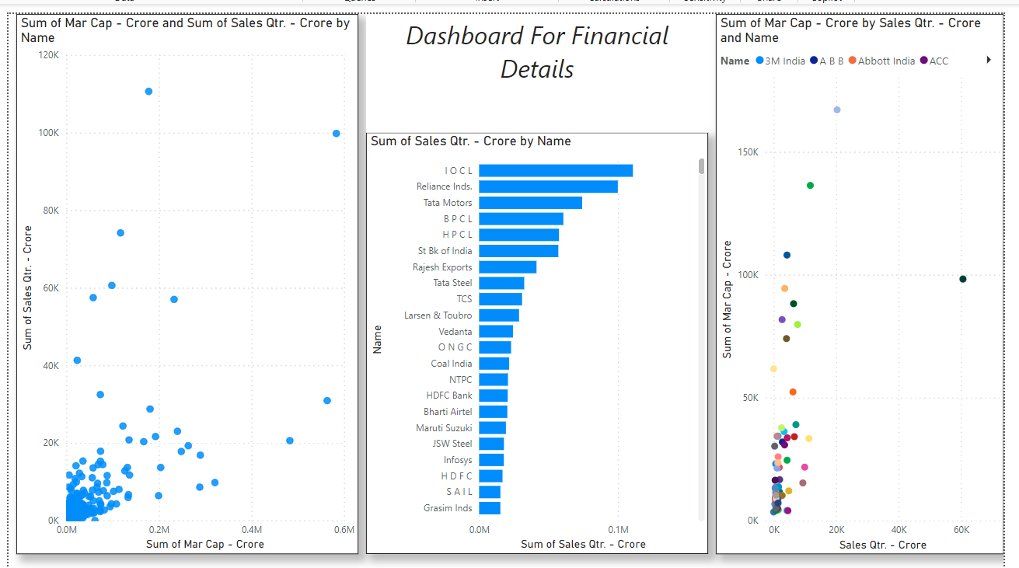
Dashboard

Slide 6
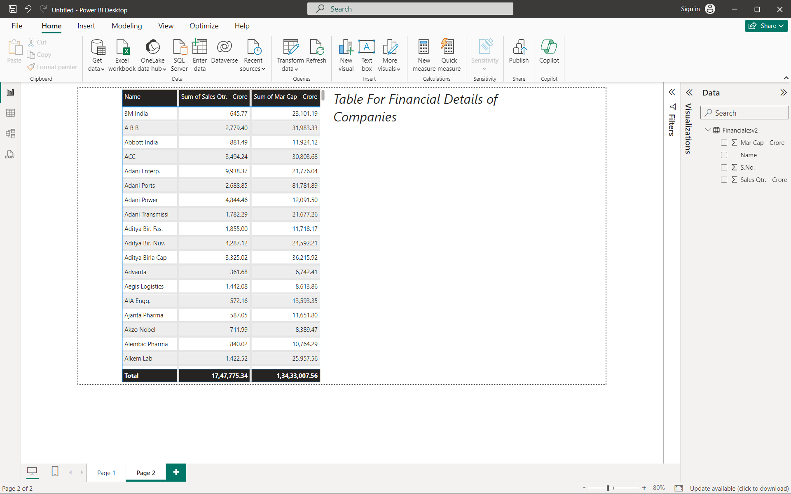
Table

Slide 7
Thank You

